Slide 1
Designing and Testing Mobile Apps
For Accessibility

Slide 2

Jeff Singleton
Senior Accessibility Solutions Consultant, ACP
Over two decades of evaluating and supporting information and communication technology
In depth knowledge of accessibility guidelines, standards and assistive technologies
Lectures on accessibility topics at National and International Disability and Technology Conferences
Developed and taught various training programs and courses focused on accessibility compliance

Slide 3
Mobile Devices and Accessibility

Slide 4
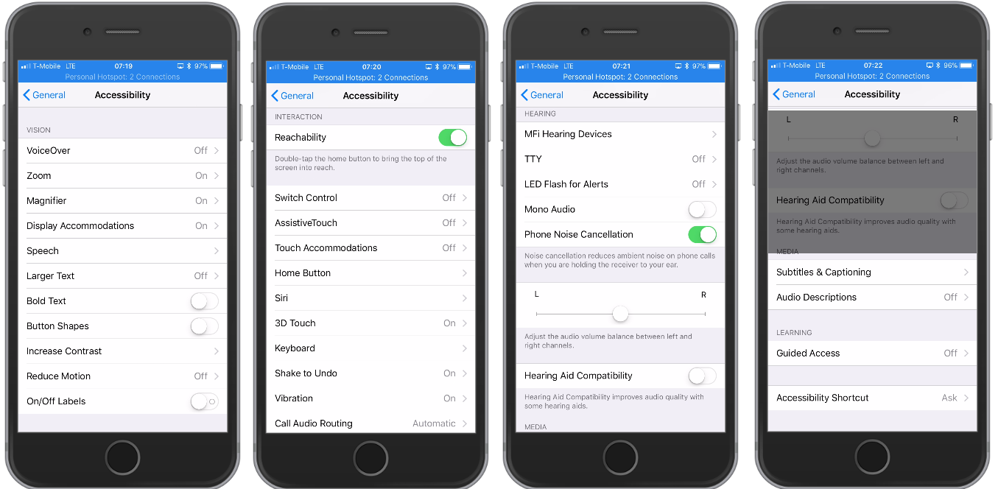
iOS Devices

Slide 5
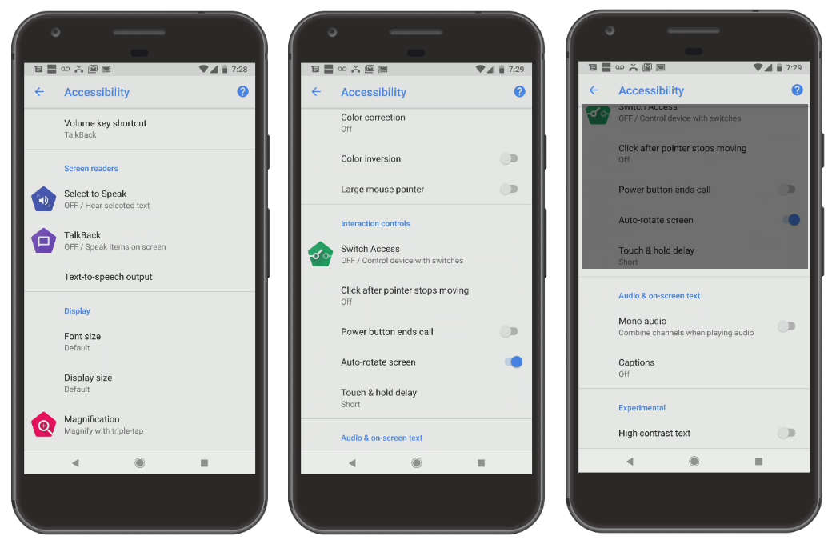
Android Devices

Slide 6
Wireframes, Mock-Ups, etc.

Slide 7
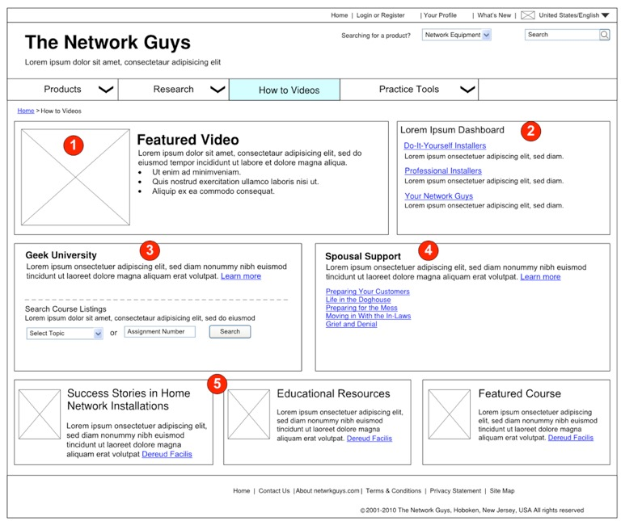

Slide 8
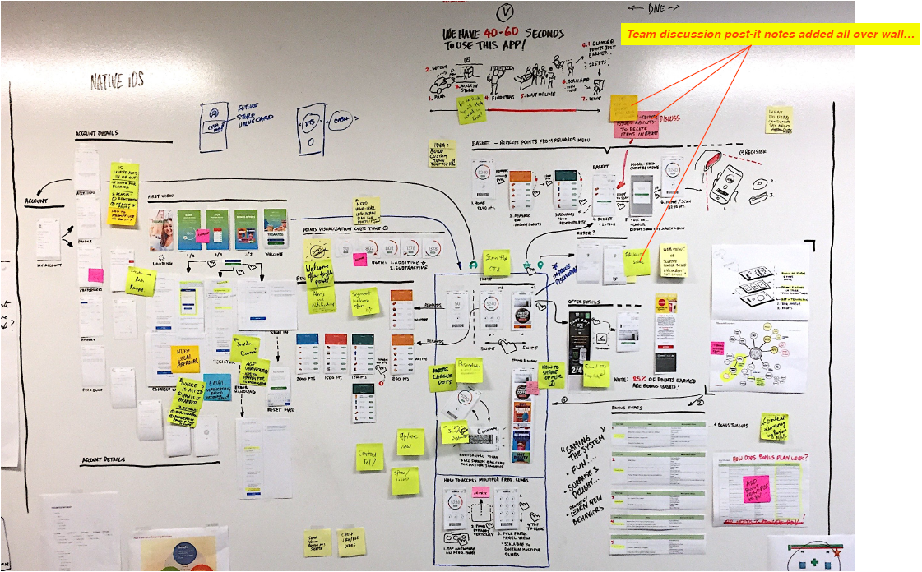

Slide 9
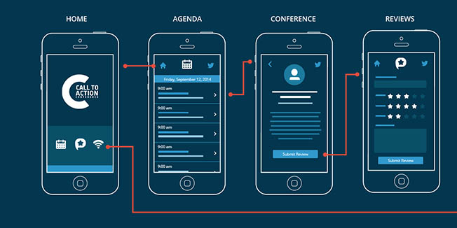

Slide 10
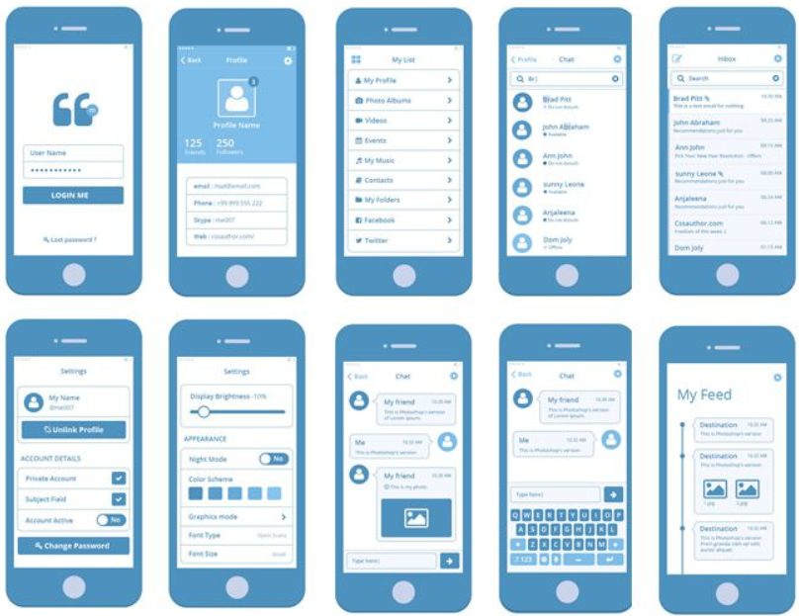

Slide 11
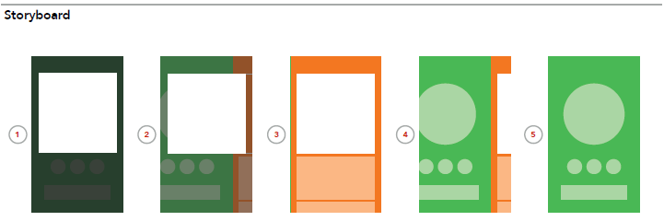

Slide 12
Reviewing the Design

Slide 13
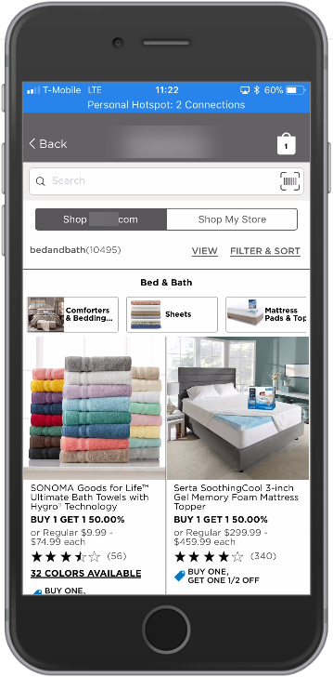

Slide 14
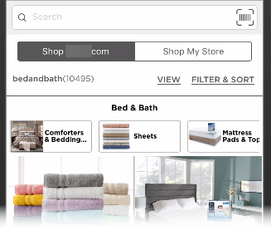

Slide 15
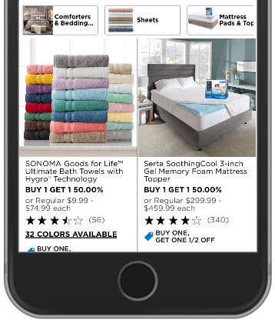

Slide 16
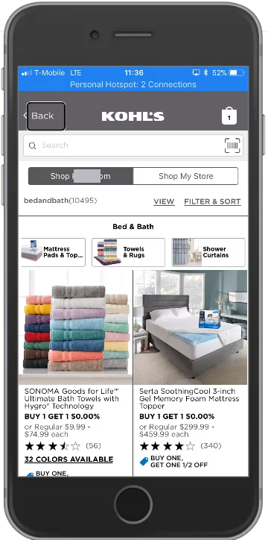

Slide 17
Avoiding Issues

Slide 18
Document Details
Element | Alt text Written for all images | Title attributes Written for image that prompt the user to action | Long description Written for complete images, such as image maps.
5.2 Thank You Page
Survey | Feedback survey | Complete this survey to give us your feedback
Yes image | Yes
No image | No
5.3 E-mail Preference Layer
Cancel Button | Cancel | Click here to cancel and close this window
Save button | Save | Click here to save settings
Close button in upper-right corner | Close | Click here to cancel and close this window

Slide 19
Mobile Apps Review the process

Slide 20
Basic Principles Apply
Review design to identify potential accessibility issues
Provide enough detail to avoid programming inaccessible features

Slide 21
Q&A

